Slide 1
Minitab Workshop Assignment (Day#1)
Prepared by:
Mohammad Taqi Daqiq
Indian institute of Technology Roorkee
Saharanpur

Slide 2
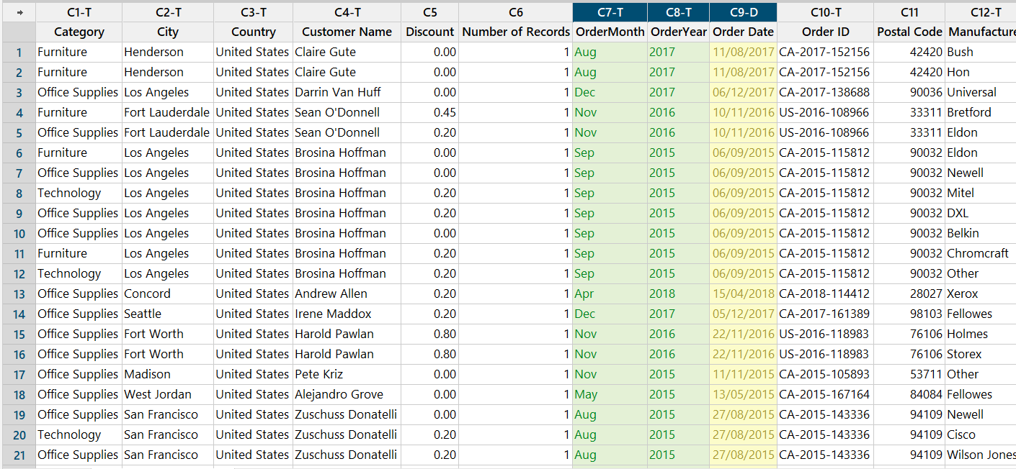
A. Line plot task 1. Extract OrderMonth and Order Year from the column 'Order Date'

Slide 3
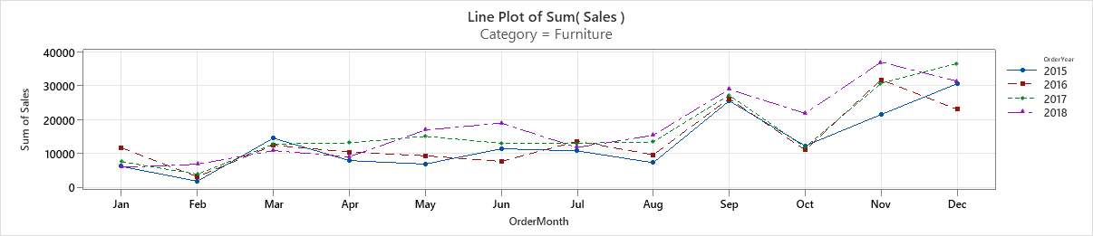
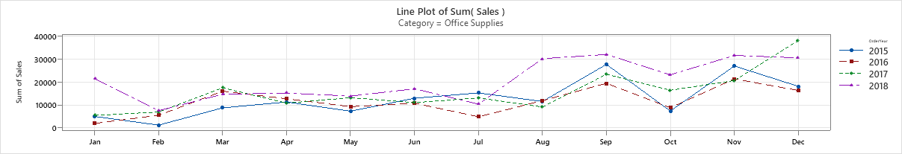
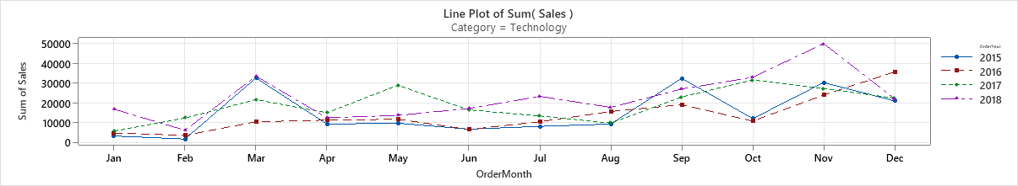
A. Line plot task 2. Plot the line plot for each category by Sales & Profit

Slide 4
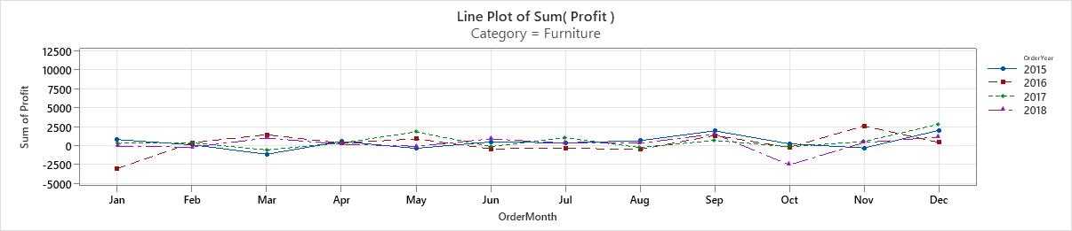
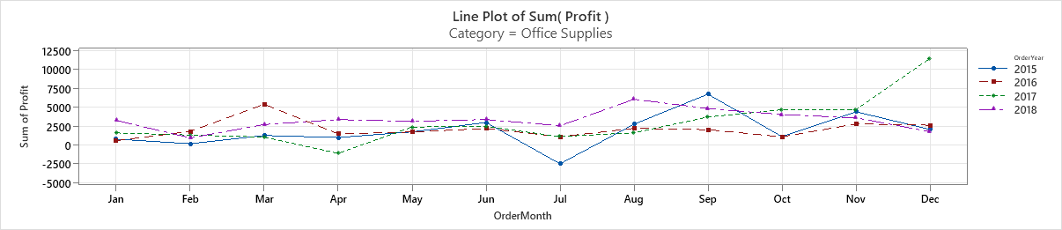
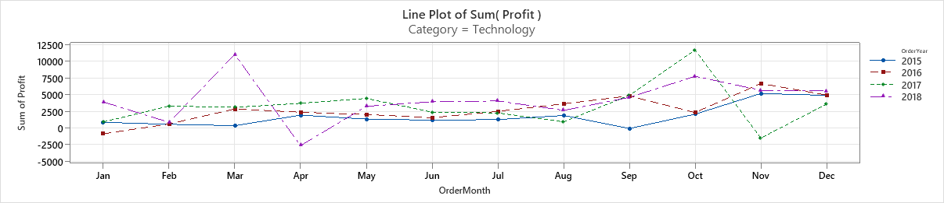

Slide 5
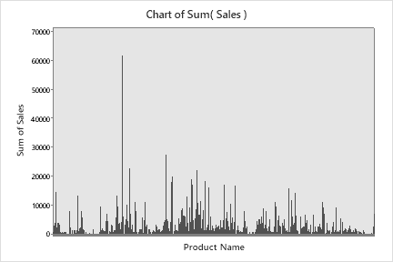
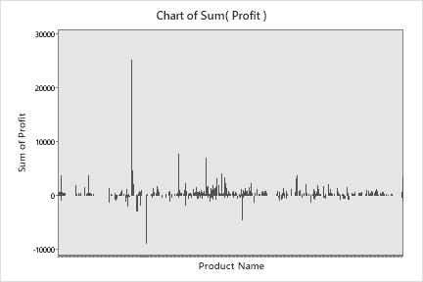


B. Top lines and bottom lines by (Sales & Profit) 1. Overall Top products & Bottom products
The most top sale product is “Canon imageCLASS…” with the sum value of 61599.8 USD which is the top profitable product.

Slide 6
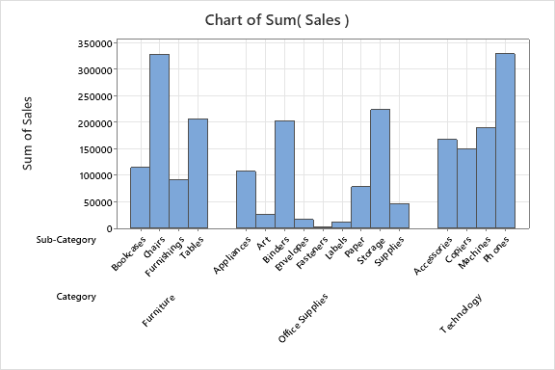
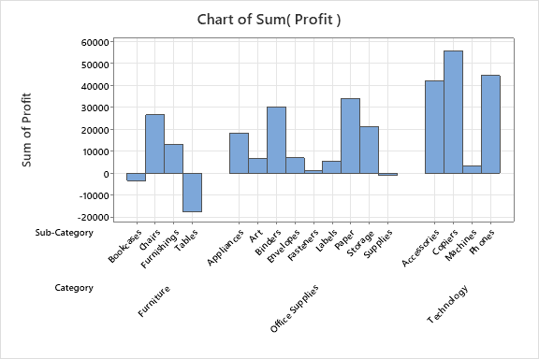
B. Top lines and bottom lines by (Sales & Profit) 2. By Category -- Subcategory - Top products & Bottom products
- Top sale category products: Technology, Furniture and Office supplies respectively.
- Top sale sub-categories are: Phones and Chairs
- Top profitable products: Category of Technology and sub-category of Copiers.
- Bottom profitable product is: Table.

Slide 7
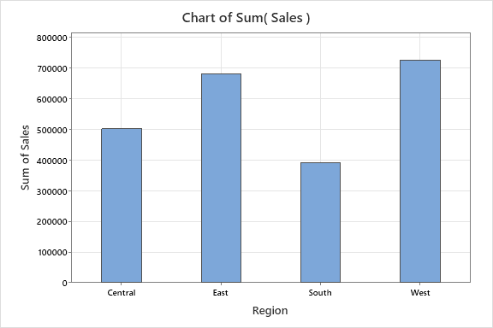
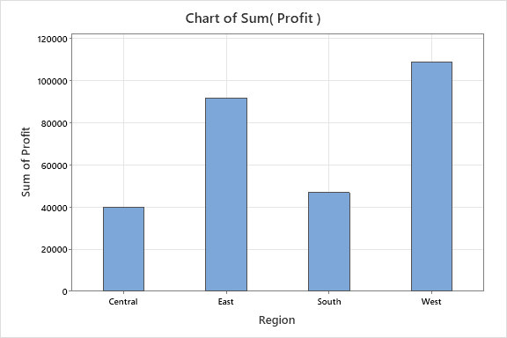
B. Top lines and bottom lines by (Sales & Profit) 3. By Region - Top products & Bottom products
- The top sale and most profitable region is the West region.
- The least profitable region is the Central region despite of it is moderate sale.
- It is advised to analysis the central region sale data with more detail.

Slide 8
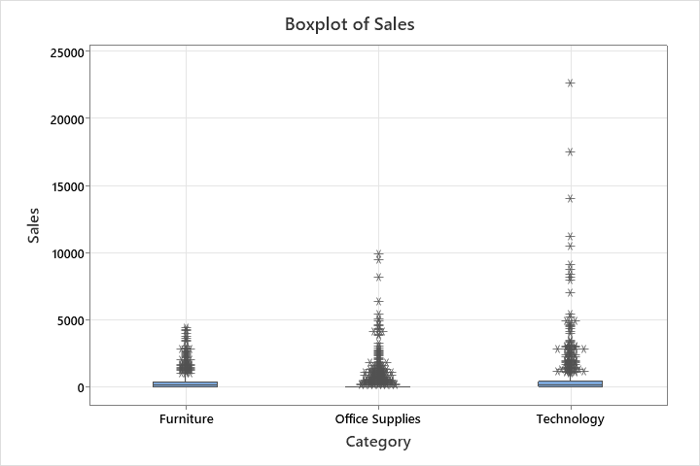
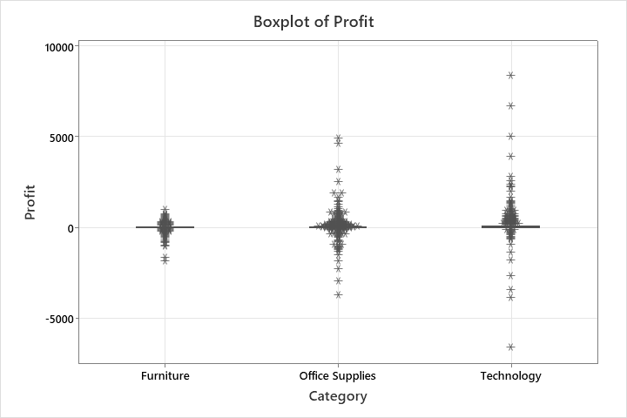
C. Box Plot 1. By Categories
- Due to the wide outliers, the box elements are not in scale.

Slide 9
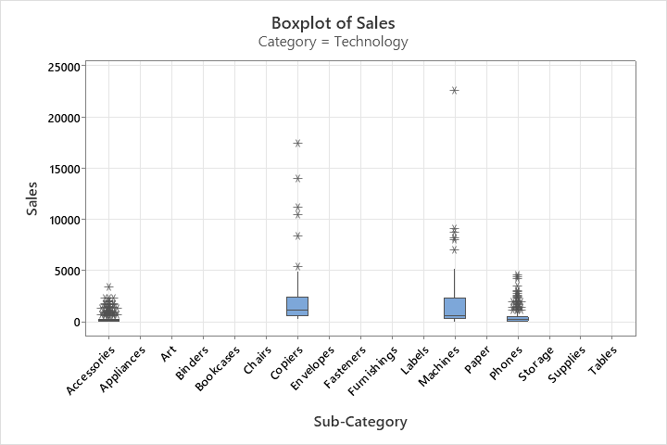
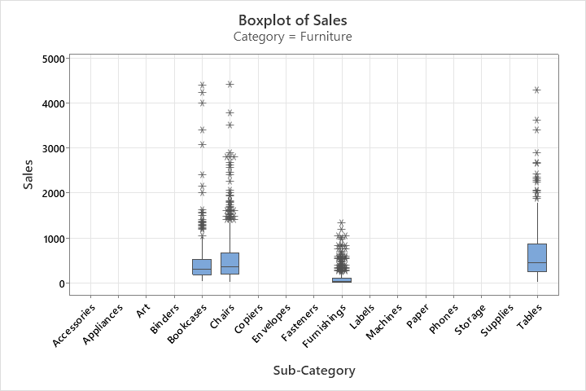
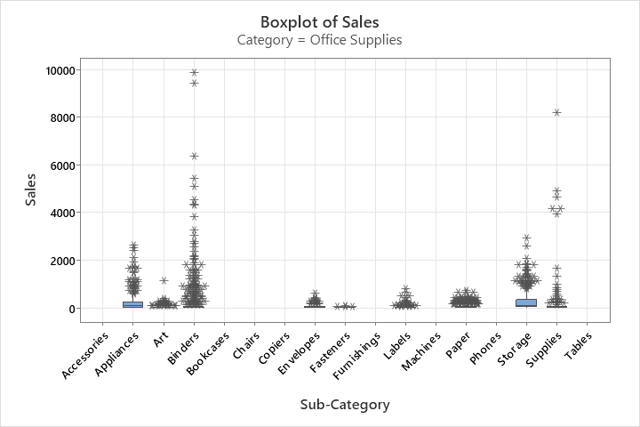
C. Box Plot 1. By Sub-category for each category
- Due to the wide outliers, the box elements are not in scale.

Slide 10
